Slide 1
Customer Retention Case Study Presentation
Prepared by
Sanjog Dhanvijay

Slide 2
Agenda :
Introduction
Problem Statement
Objective
Exploratory Data Analysis (EDA)
Visualization
Future Work

Slide 3
Introduction :
What is Customer Retention?
Customer retention refers to company’s ability to turn customers into repeat buyers and prevent them from switching to a competitor.
This happens only if there exists a positive relation between the company and the customer.

Slide 4
Benefits of Customer Retention :
Retained customers tend to buy other services from same company.
Retained customers are known to be less price/cost sensitive
The probability of selling to an existing customer is 60-70%
The probability of selling to new prospect is 5-20%
It’s more expensive to acquire a new customer than to retain an old one.

Slide 5
Problem Statement :
Customer satisfaction has emerged as one of the most important factors that guarantee the success of online store; it has been posited as a key stimulant of purchase or repurchase intentions and customer loyalty.
The combination of both utilitarian value and hedonistic values are needed to affect the repeat purchase intention (loyalty) positively.
The data is collected from the Indian online shoppers. Results indicate the e-retail success factors, which are very much critical for customer satisfaction.

Slide 6
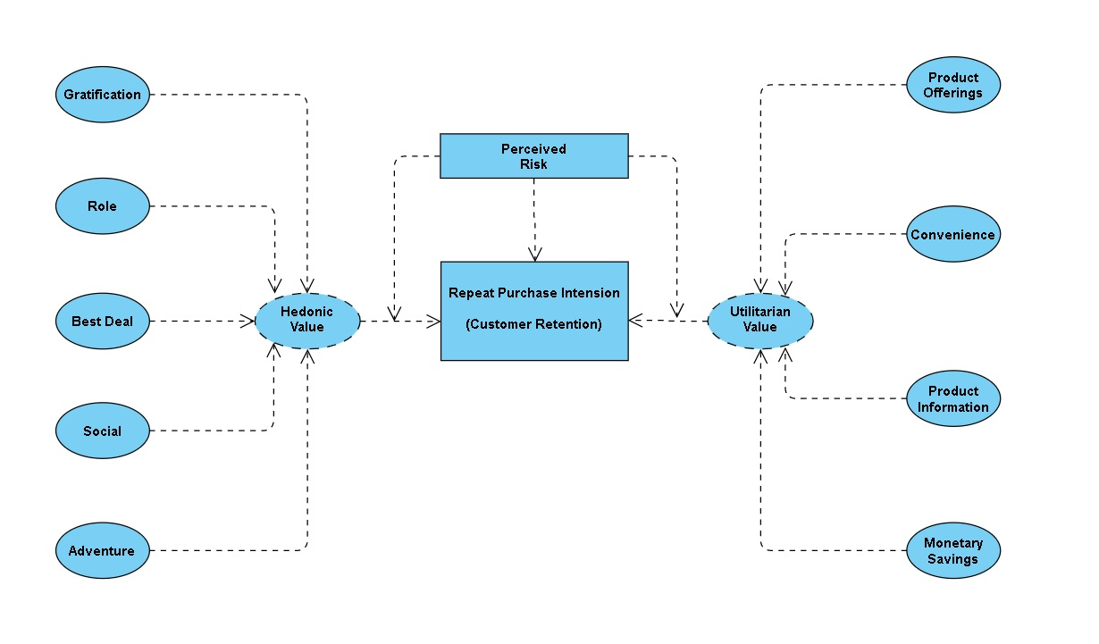
The problem statement can be represented in the form of below use case diagram as well.

Slide 7
Objective :
The objective is to apply the analytical skills to provide findings and conclusion that would help to predict customer retention for a E-Retail company using their data on users provided over period of time.
Using the model I was tasked with determining which features were most influential in loss of valuable customer and then making a plan for how the company could use this information to increase customer retention.

Slide 8
Exploratory Data Analysis (EDA) :
First I have imported the necessary libraries and loaded the entire dataset in our Jupyter Notebook and renamed the columns.
Then I checked the shape of our dataset and found that we have a total of 269 rows and 71 different columns.
We don’t have any null values or missing values present in our dataset.
There is 22% percent of duplicate records in our dataset however I have chosen to retain those information instead of removing them.
By checking the data types I came to know that all the columns have ‘object’ data type except the column representing the Pin Code which has ‘integer’ data type.

Slide 9
Dataset Description :
The data is collected from the Indian online shoppers. Our Dataset consists of reviews and feedbacks of customers on 5 top Indian Online Retailers : Amazon, Flipkart, Snapdeal, Myntra and Paytm.
Questionnaire is formed on the basis of brand strength, brand empathy or commitment, overall customer satisfaction and perceived value for money with intention to recommend.
Results indicate the e-retail success factors which are very much critical for customer satisfaction and retention.

Slide 10
Visualization :
What is Data Visualization? Data visualization is defined as a graphical representation that contains the information and the data.
Benefits of Good Data Visualization? Data visualization is another technique of visual art that grabs our interest and keeps our main focus on the message captured with the help of eyes.
Different Types of Analysis for Data Visualization are Univariate Analysis: In the univariate analysis, we will be using a single feature to analyze almost all of its properties. Bivariate Analysis: When we compare the data between exactly 2 features then it is known as bivariate analysis. Multivariate Analysis: In the multivariate analysis, we will be comparing more than 2 variables.

Slide 11
Univariate Analysis:
With the help of count plots I was able to get the total number of rows covered by each unique categorical value present in all the columns of our dataset.
I ensured that along with the total row number the percentage of data coverage is made visible too.

Slide 12
Bivariate Analysis:
Using the count plot along with the hue parameter I was able to generate analysis details comparing 2 columns of the dataset where the hue remained constant while the other one kept changing inside a loop.
The hue used in this plot is the “Gender” column showing the legend accordingly.

Slide 13
Multivariate Analysis:
I used the histogram after encoding all the columns of our dataset.
Since histogram only understand numeric values it would not have generated a diagrammatic representation of object datatype columns.
Once the encoding was complete the histograms showed the information.

Slide 14
Inference :
The case study from Indian e-commerce customers showed Amazon and Flipkart has been used mostly for Online Shopping and most recommended by Friends. So based on the research factors Amazon and Flipkart are the e-commerce platform which are having the combination of both utilitarian and hedonistic values to keep the repeat purchase intention (loyalty) positively.

Slide 15
Future Work :
I will need to perform some preprocessing on the data for example using the scaling techniques
Since I have mostly categorical data present in the dataset I am not going to worry about removing outliers or skewness
Need to build some unsupervised machine learning models
Will have to verify the clustering or association algorithm details that can be used on the dataset.

Slide 16
Thank You!

